Slide 1

Prediction of Calories Burned Using Machine Learning
This presentation explores the use of machine learning to predict calories burned during physical activity. We will delve into the factors influencing calorie expenditure, the algorithms employed, and the performance metrics used to evaluate our models. Our goal is to provide a comprehensive overview of the project and its potential applications in fitness tracking and personalized health management.

Slide 2
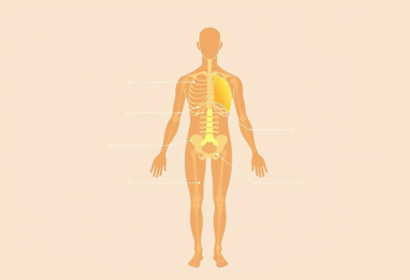


Calorie Burning Aspects
Basal Metabolic Rate (BMR)
Activity Level
Thermic Effect of Food (TEF)
BMR represents the energy your body needs at rest for basic functions. Factors like age, gender, and genetics influence it.
The intensity and duration of physical activity significantly impact calorie expenditure. More intense and longer activities burn more calories.
TEF is the energy your body uses to digest, absorb, and process nutrients. Protein has a higher TEF than fats or carbs.
Understanding these aspects is crucial for accurate calorie prediction. We aim to capture their interplay in our machine learning models.

Slide 3

Weight Loss vs Fat Loss
Misconceptions
Calorie Deficit
Many people confuse weight loss with fat loss. Weight loss can include water weight, muscle mass, and fat, while fat loss specifically targets adipose tissue.
Creating a daily calorie deficit is essential for fat loss. This means consuming fewer calories than your body burns, forcing it to tap into fat stores for energy.
Protein Intake
Adequate protein intake is crucial during weight loss to preserve muscle mass. It also helps increase satiety and boost metabolism.

Slide 4




High Protein, Low-Calorie Diet
Diet Composition
A diet high in protein and low in calories can be effective for fat loss while preserving muscle mass.
Macronutrient Ratio
Focus on a balanced macronutrient ratio with a higher proportion of protein and lower carbohydrates.
Benefits
This approach supports satiety, boosts metabolism, and helps maintain a healthy body composition.

Slide 5
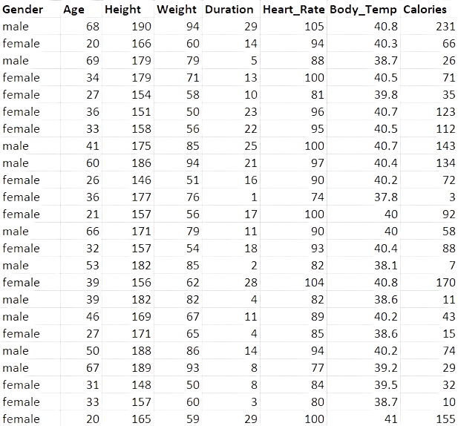
Dataset Attributes
Attribute
Description
Gender
Male or Female
Age
Age in years
Height (cm)
Height in centimeters
Weight (kg)
Weight in kilograms
Duration (minutes)
Duration of activity in minutes
Heart Rate (BPM)
Heart rate in beats per minute
Body Temperature (°C)
Body temperature in degrees Celsius
Calories Burned
Calories burned during activity

Slide 6
Algorithms Used
XGBoost Regressor
Random Forest Regressor
Decision Tree Regressor
AdaBoost Regressor
XGBoost is a powerful gradient boosting algorithm known for its accuracy and efficiency.
AdaBoost is an ensemble boosting technique that combines weak learners to create a strong learner.
Random Forest is an ensemble learning method that combines multiple decision trees for improved prediction.
Decision Tree is a simple yet effective algorithm that creates a tree-like structure to make predictions.
Each algorithm offers unique advantages in predicting calorie burn based on the dataset attributes.

Slide 7
Model Performance
XGBoost Regressor
Random Forest Regressor
Decision Tree Regressor
AdaBoost
Regressor
Most accurate with the lowest errors.
Close second, performs well in accuracy.
Decent performance with slightly higher errors.
Least effective model for this task Has low accuracy
MAE: 1.45
MAE: 1.74
MAE: 3.42
MAE: 9.33
MSE: 4.55
MSE: 7.99
MSE: 29.57
MSE: 132.84
Accuracy: 99.88%
Accuracy: 99.79%
Accuracy: 99.25%
Accuracy: 96.62%

Slide 8

Key Takeaways
and Next Steps
1
Accurate Prediction
2
Personalized Fitness
Machine learning algorithms can accurately predict calories burned based on physiological and activity data.
These models can be used to personalize fitness recommendations and track progress more effectively.
3
Further Research
Future research should focus on incorporating more diverse datasets and exploring advanced algorithms for improved accuracy.

